Slide 1


Behavior-Based Authentication for Mobile Banking
Team Name : CrazyBankers
Team Members : Deepankar Mishra (L),
Dhanush Hebbar,
Kumarjit Kumar,
Sachin Saini
College : Indian Institute of Information Technology(IIIT), Kottayam

Slide 2

System Architecture
Background Data Collection
Continuously collects tap, scroll, typing, and motion data during app use.
Each modality operates independently to trigger its own data pipeline in real time.
Preprocessing & Feature Extraction
Raw inputs are cleaned, normalized, and segmented.
Extracts features like heatmaps, sensor windows, and typing metrics like key dwell time.
One-Shot Inference via Siamese Networks
Each modality’s data is passed to a dedicated Siamese model (Tap CNN, Sensor GRU, Keypress GRU).
The models output a distance vector representing deviation from known user behavior.
Recommendation Engine
Aggregates distance vectors from all modalities and applies z-score normalization to calculate the final anomaly score.
Drives action selection based on severity thresholds.
Action Execution & Session Cleanup
Executes real-time responses (e.g., logout, OTP, lockout) based on threat level
Clears behavioral buffers post-session or post-anomaly to prevent contamination of future predictions.

Slide 3
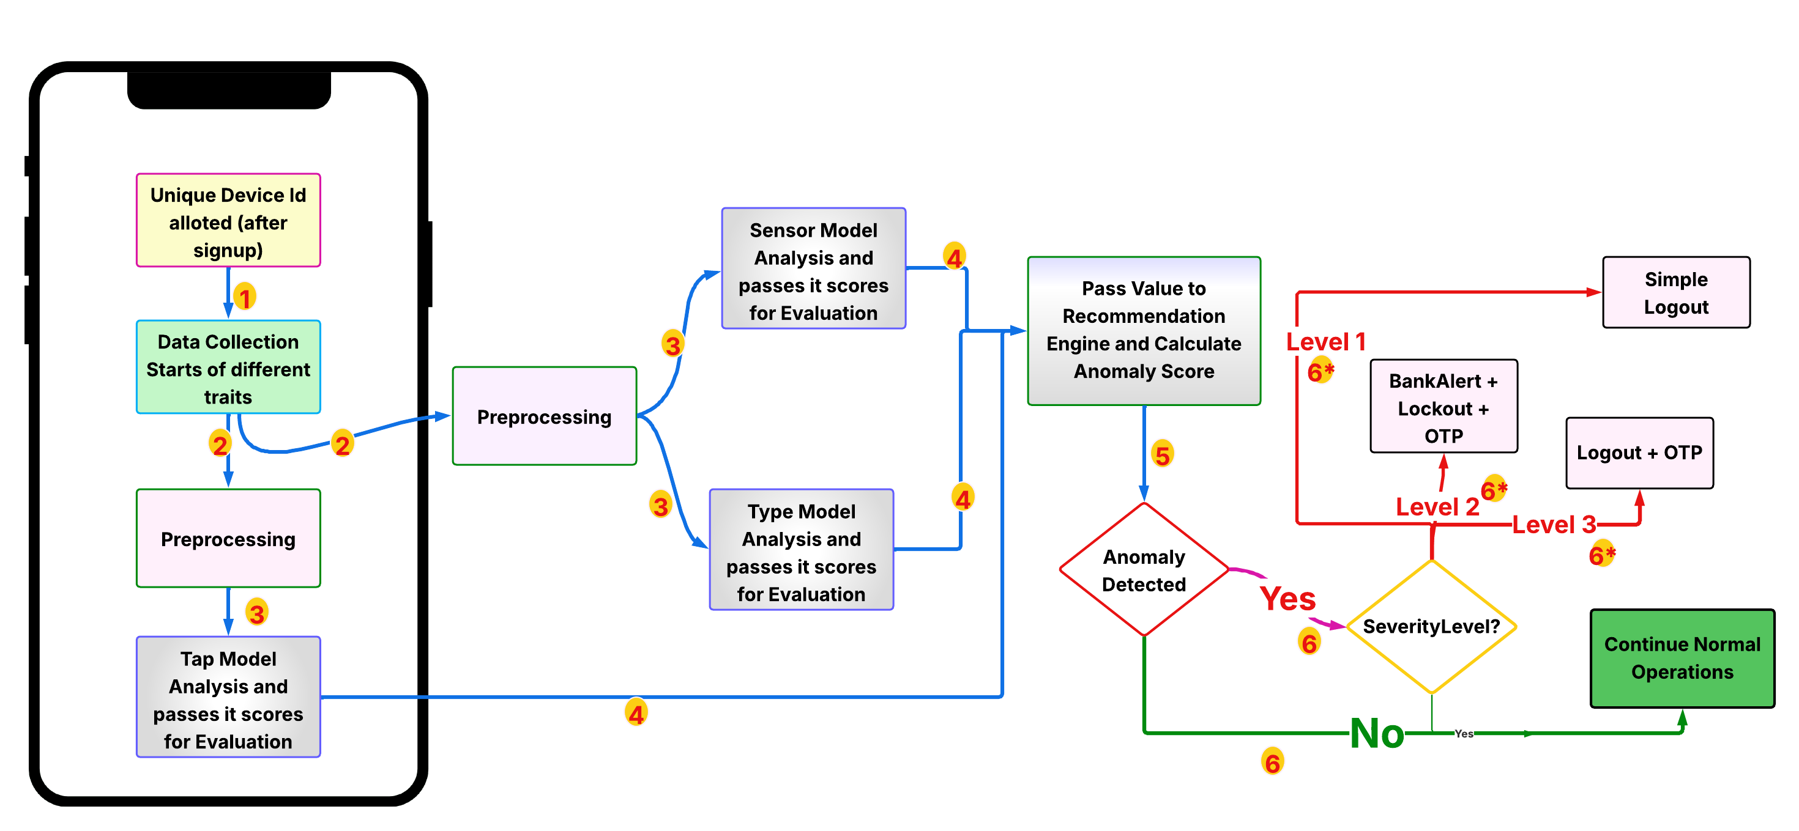

Workflow page
02
01
03
04

Slide 4


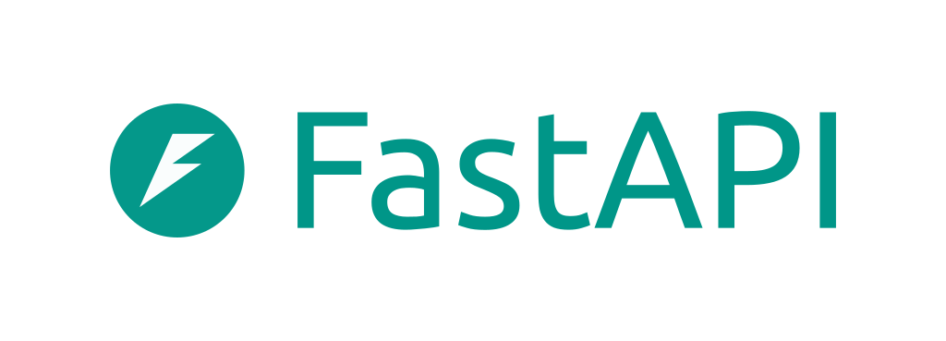


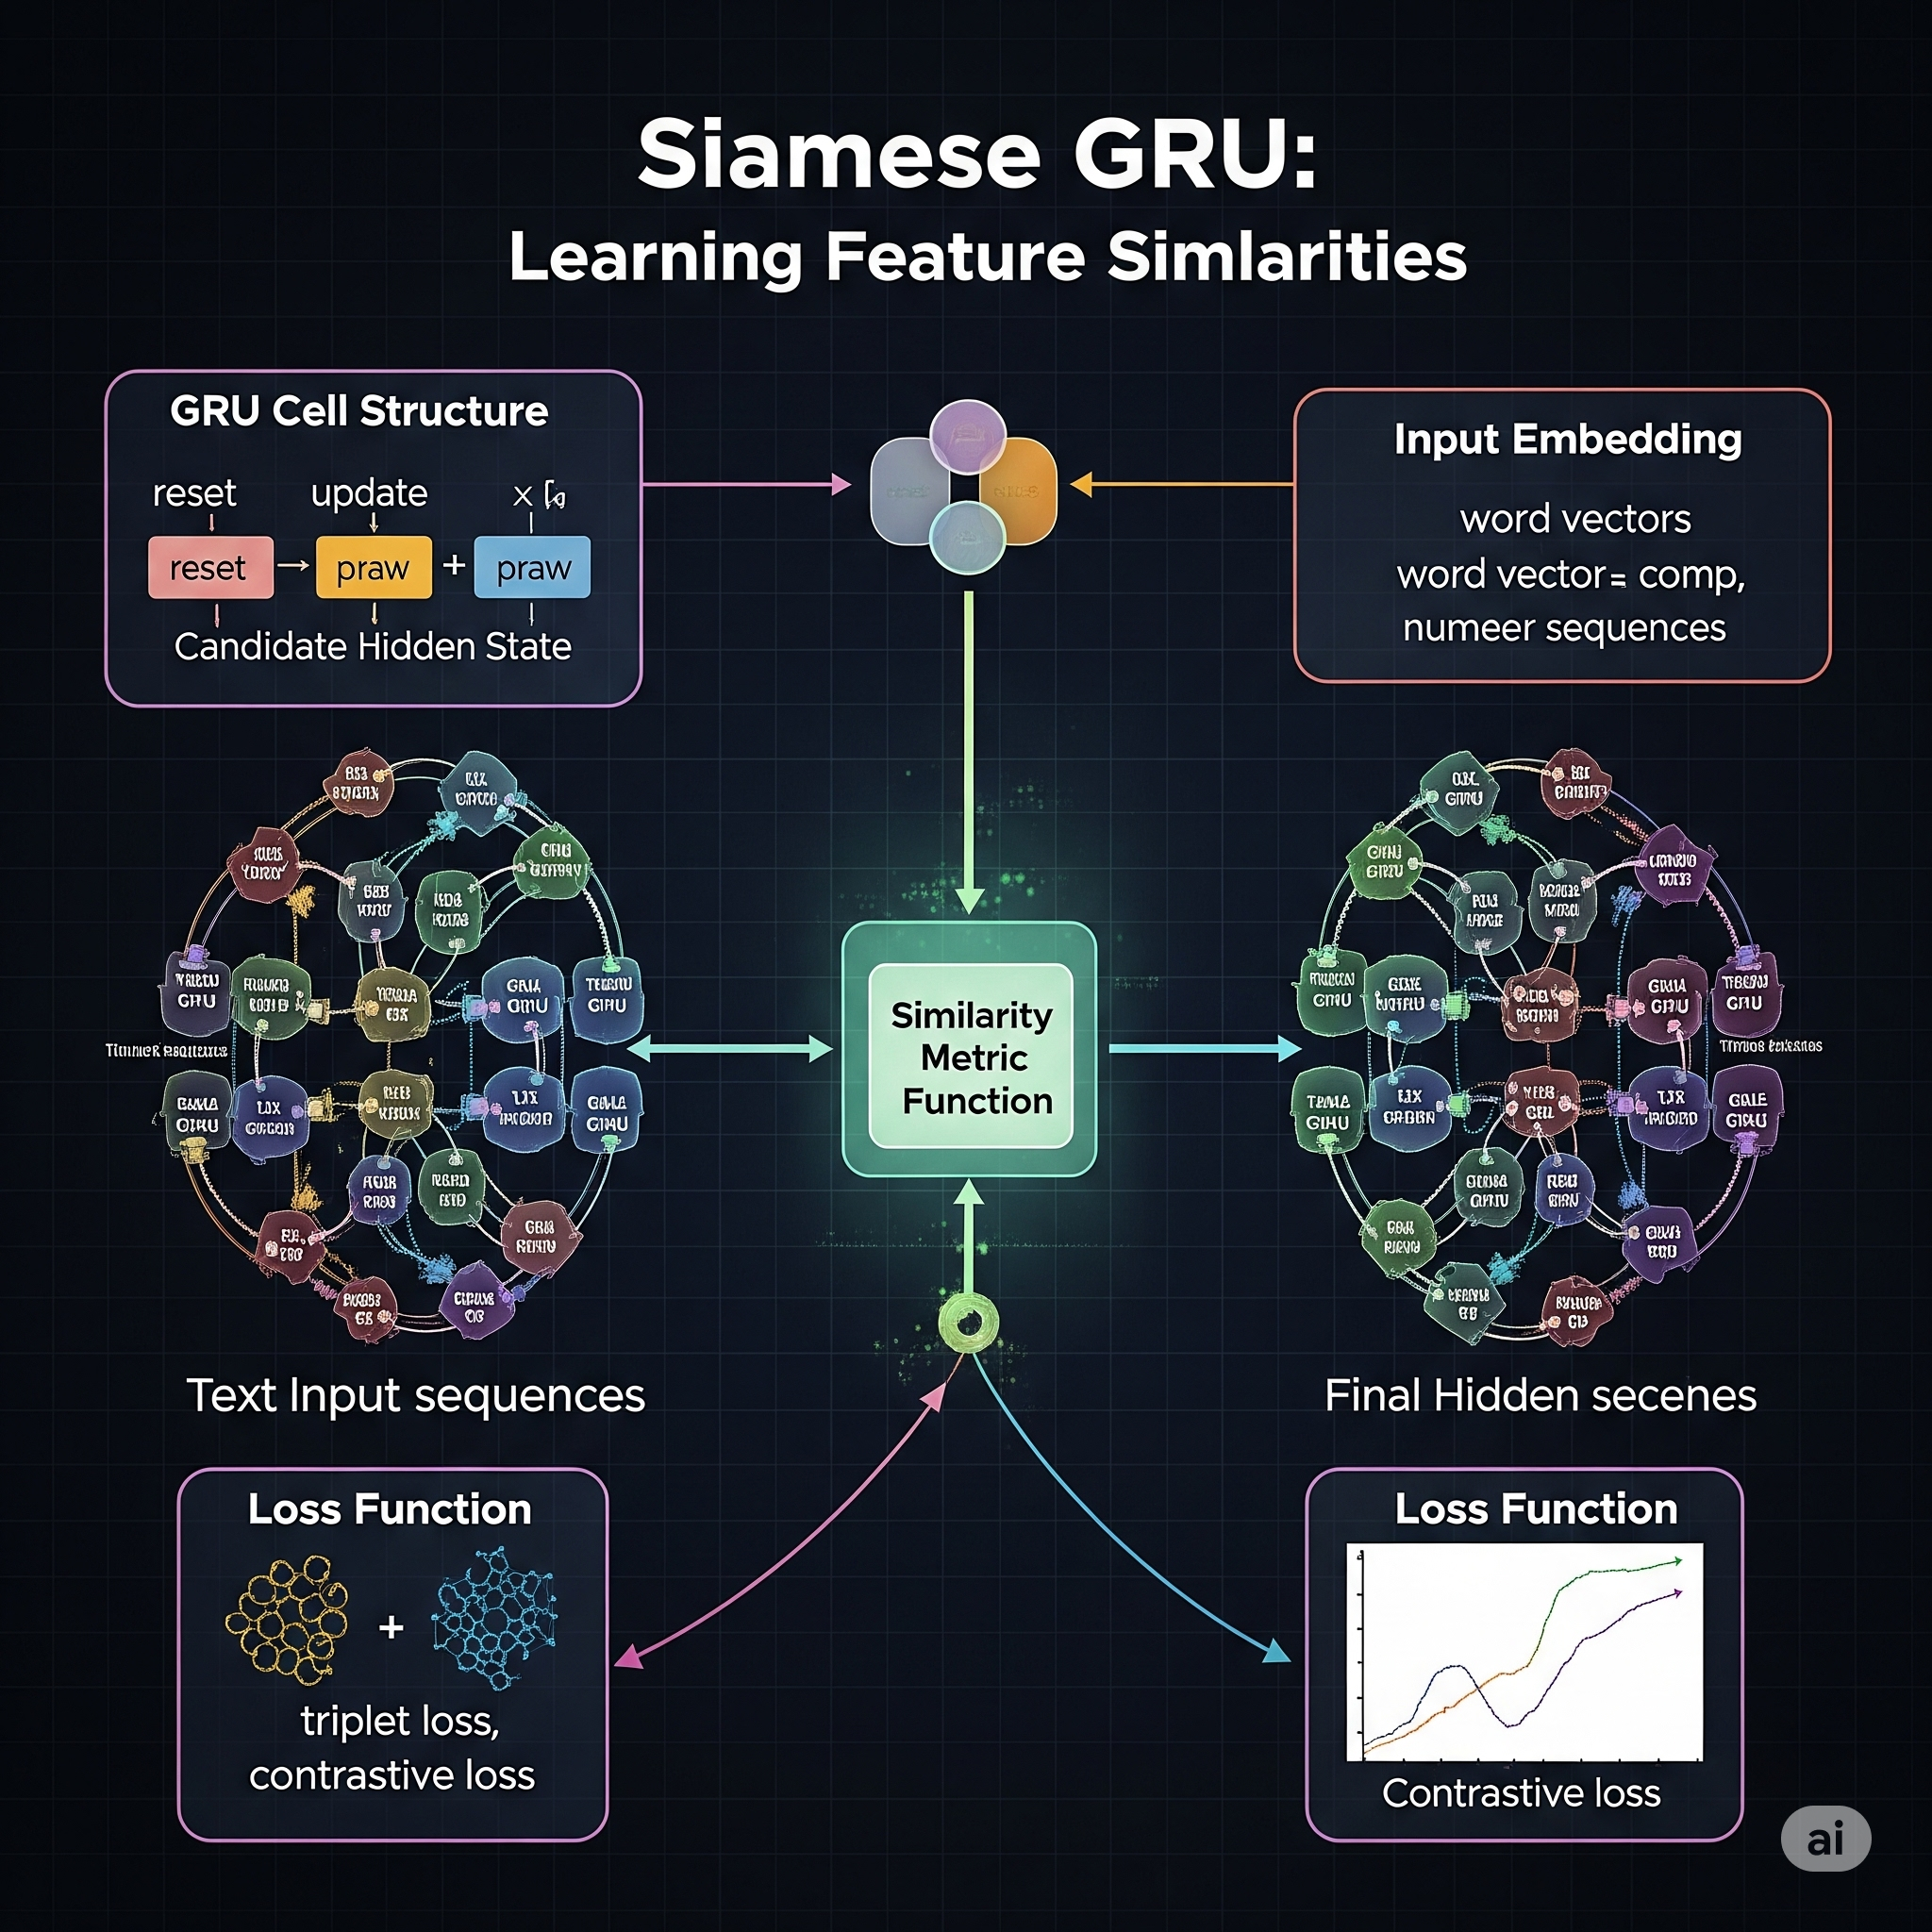



Tech Stack
Frontend :
Flutter – Cross-platform mobile app development platform.
Backend :
FastAPI – Handles RESTful APIs for data ingestion and model inference.
SQLite – Lightweight storage for session and scoring metadata.
Firebase Authentication – Secure, scalable login and identity management.
Machine Learning :
Framework: PyTorch, TensorFlow
Architecture: Siamese Network-based behavioral modeling.
Models:
• Tap Model: Heatmap CNN
• Sensor Model: GRU (windowed motion + interaction data)
• Keypress Model: GRU (dwell time + inter-key timing)
Model Storage :
Local file-based storage for model weights, inference logs, and temporary data.

Slide 5
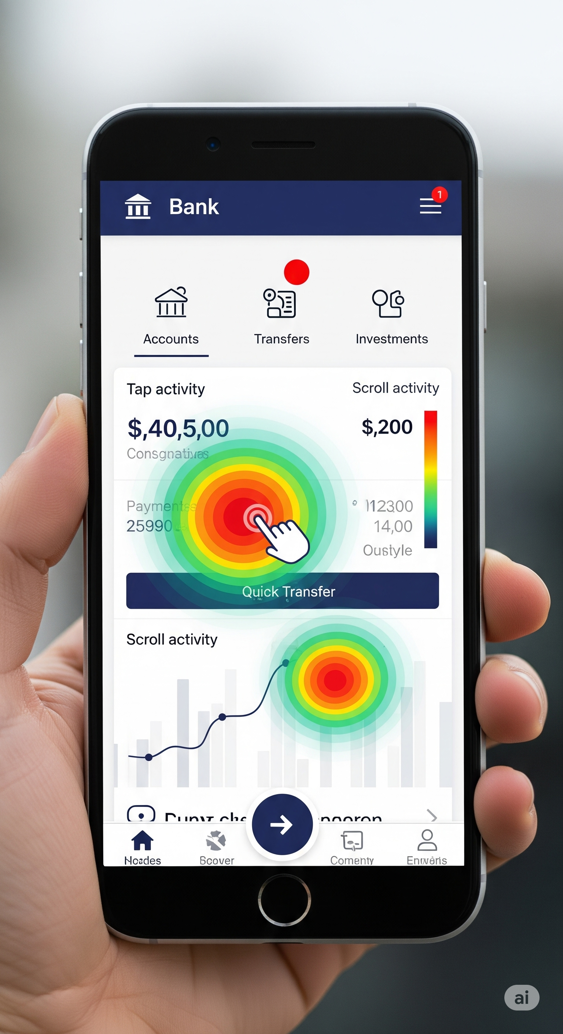
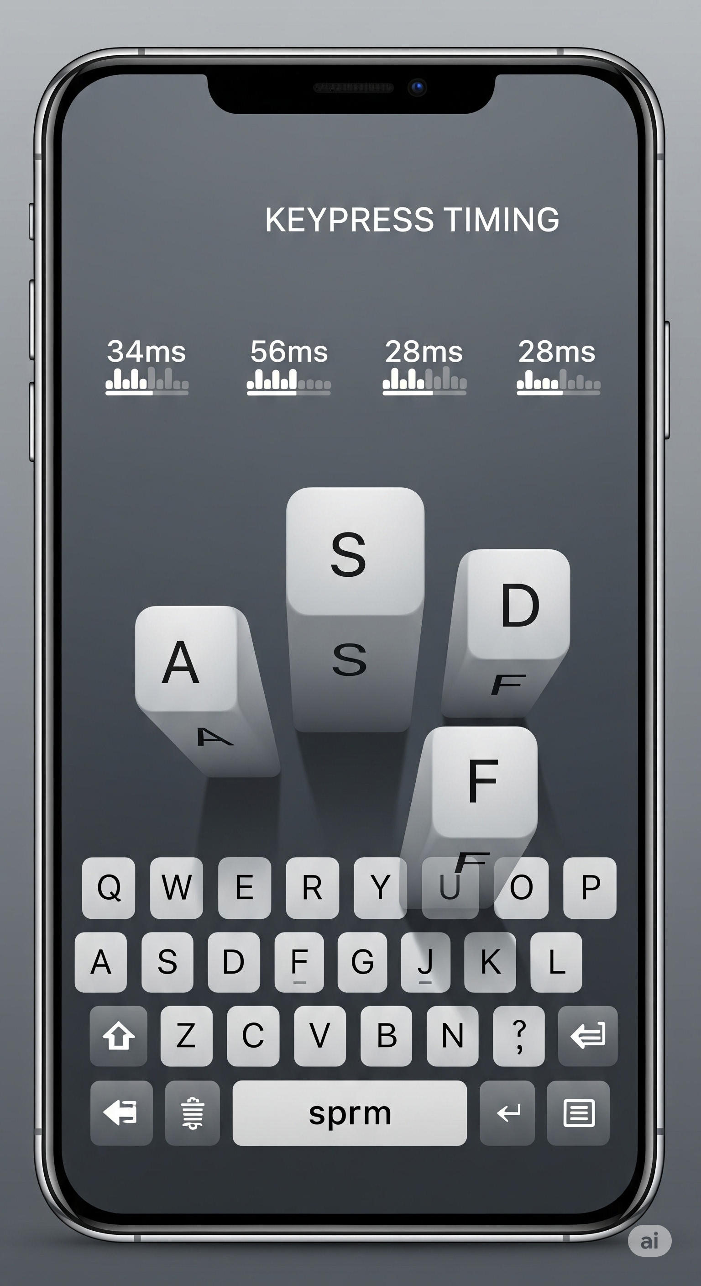
Functionality
Tap Model – Siamese Heatmap CNN :
Captures tap coordinates to generate personalized heatmaps.
Learns screen-specific behavior such as commonly visited areas and tap sequences.
Detects anomalies in tap location and screen navigation patterns.
Sensor Model – Siamese GRU :
Processes windowed accelerometer & gyroscope (x, y, z) data
Includes tap/swipe/keypress frequency during the time window.
Captures device handling behavior and detects orientation/motion irregularities.
Keypress Model – Siamese GRU :
Analyzes key dwell time and inter-key delays.
Identifies normal transaction patterns (e.g., frequent recipients or payment amounts).
Detects typing rhythm inconsistencies, signaling potential fraud or impersonation.
Recommendation Engine – Adaptive Anomaly Thresholding :
Utilizes adaptive Z-score thresholds for each model’s output.
Learns from user-specific behavior trends over time to dynamically adjust sensitivity.
Context-aware decision-making by weighing anomaly confidence across models.
Action Levels - Based on Anomaly Severity :
Low – Silent Logout
Medium – Logout + OTP
High – Logout + 30-sec Lockout + OTP (future-ready: alert banking authority)

Slide 6
Uniqueness & Real World Usage
Zero-Prerequisite Learning: Models adapt from the very first session, requiring no prior user-specific training.
Multi-Channel Decision Logic: Tap, sensor, and typing signals are evaluated independently, ensuring
continued operation even if one fails thus scalable.
Continuous Authentication: Provides real-time, passive identity verification across multiple layers.
Privacy-Preserving Design: Low resource footprint as no personal data is stored; locally generated anonymous UUIDs are used as identifiers, with no personal information collected or linked.
Optimized Performance: Only one model runs on-device. Others run remotely. Server calls are spaced 30 seconds apart to reduce battery and data usage proving its scalability.
Strict Usage & Login Separation: Behavioral logs and authentication credentials are isolated
ensuring privacy and data decoupling.
Security Response Triggers: System reacts in real-time to anomalies with adaptive actions:
logout, OTP verification, or session lockout.
Low Resource Footprint: Optimized for minimal battery, CPU, and bandwidth usage.

Slide 7

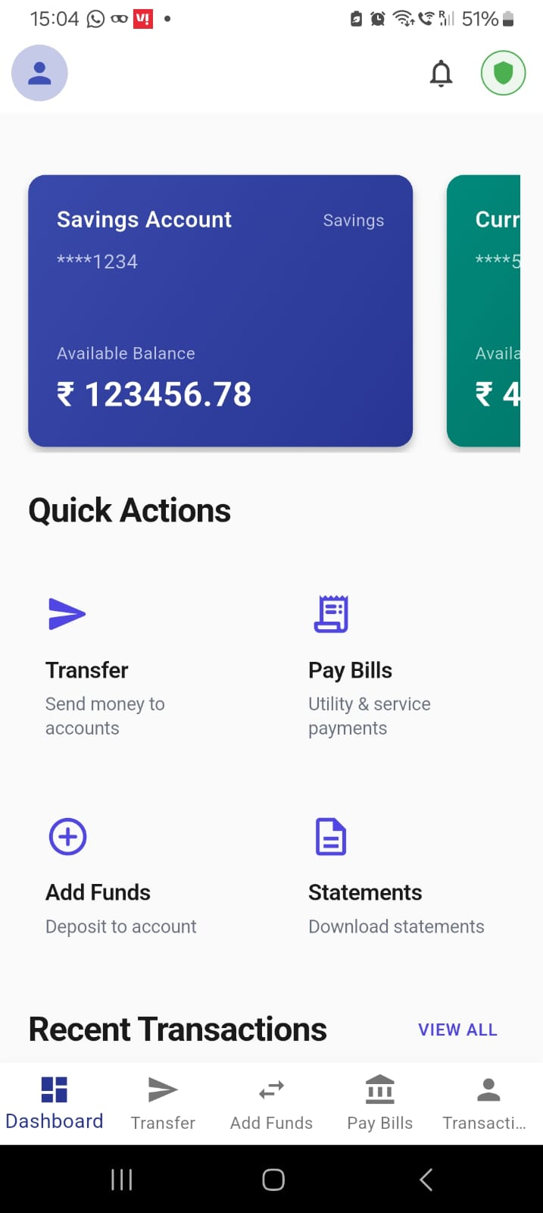


Thank You!!!!
"The secret of getting ahead is getting started."
Our Application

